Slide 1
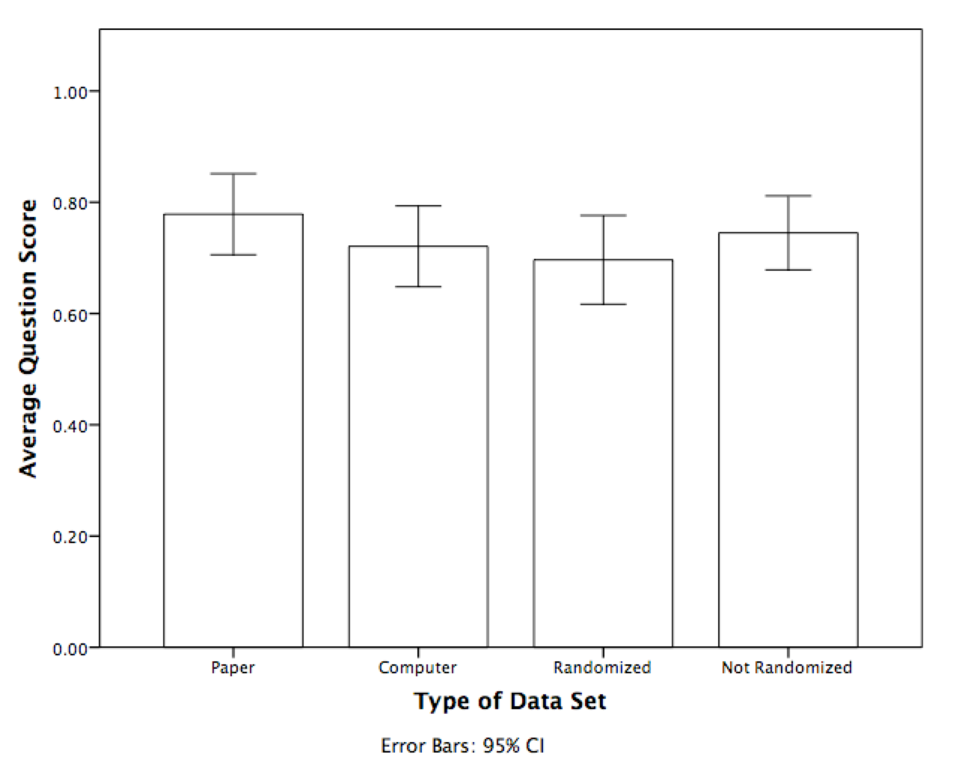
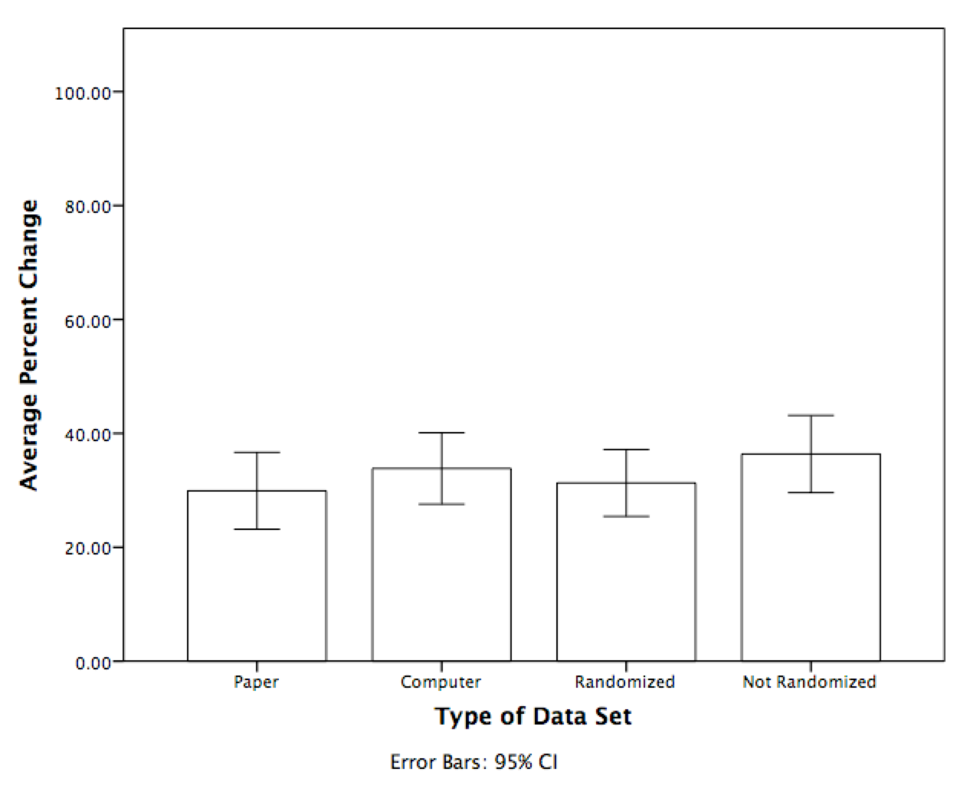
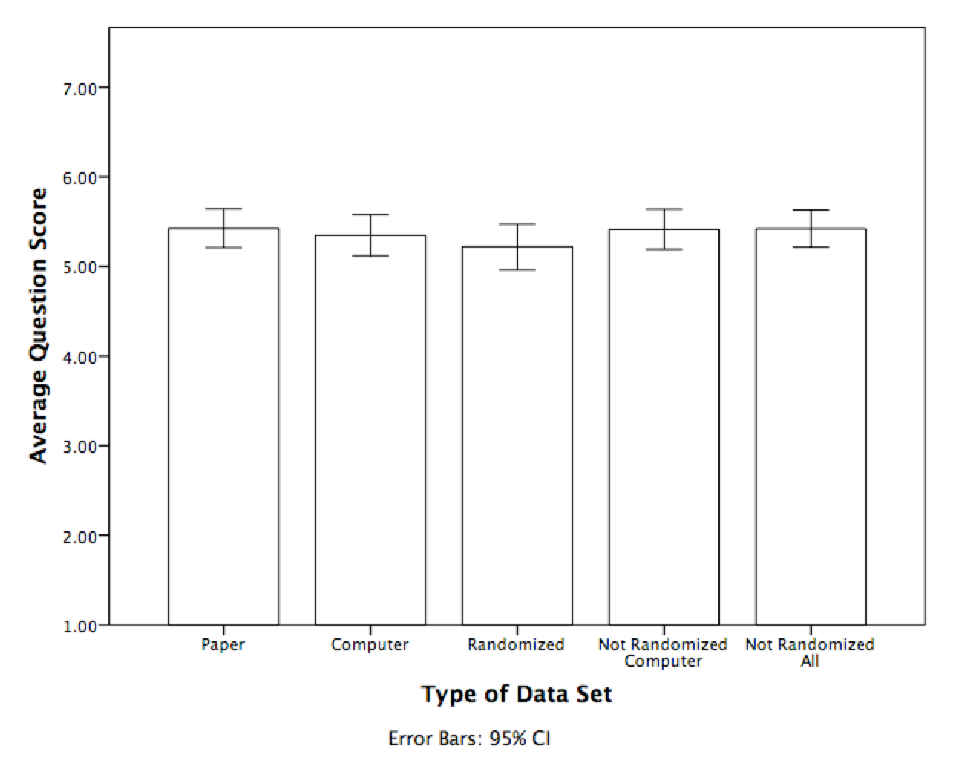
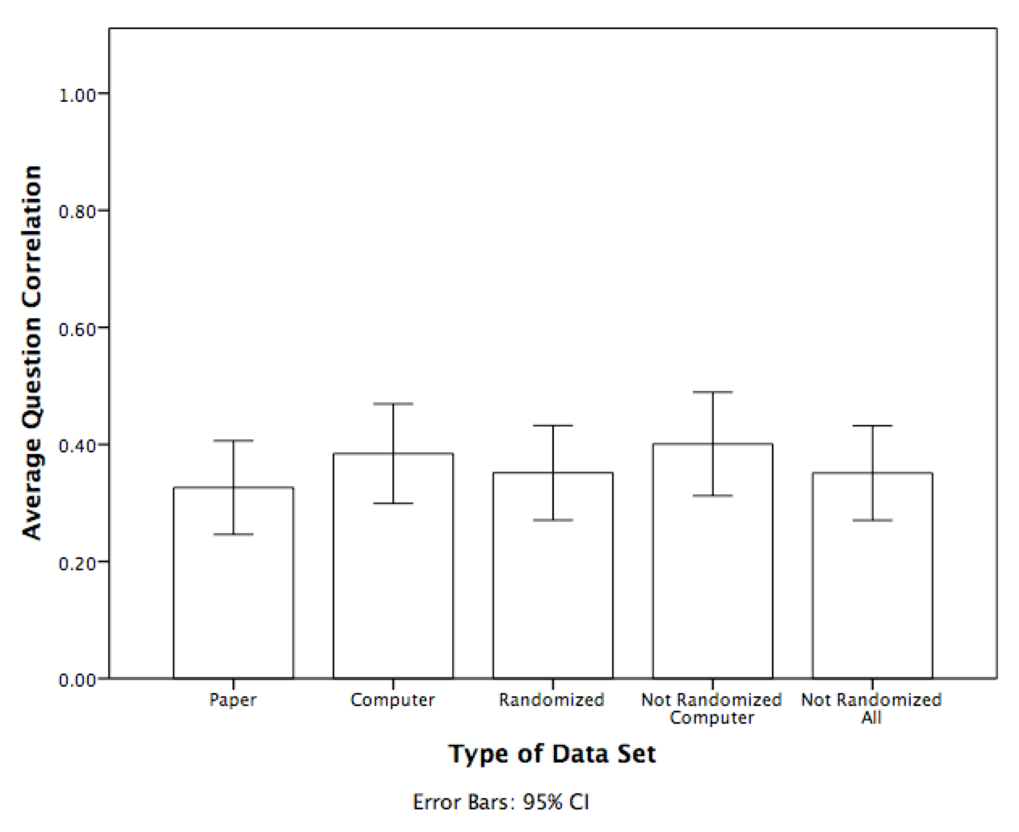
The Delivery Matters: Examining Reactivity in Question Answering
Riley E. Foreman, Marshall T. Beauchamp, and Erin M. Buchanan
Missouri State University
Abstract
 | The Purpose in Life Test (Crumbaugh & Maholick, 1964)
1 | I am usually: (1-completely bored; 7-exuberant, enthusiastic)
2 | Life to me seems: (1-completely routine; 7-always exiting)*
3 | In life I have: (1-no goals or aims at all; 7-very clear goals and aims)
4 | My personal existence is: (1-utterly meaningless, without purpose; 7-very purposeful and meaningful)
5 | Every day is: (1-exactly the same; 7-constantly new)*
6 | If I could choose, I would: (1-prefer never to have been born; 7-like nine more lives just like this one)
7 | After retiring, I would: (1-loaf completely the rest of my life; 7-do some of the exciting things I have always wanted to)*
8 | In achieving life goals I have: (1-made no progress whatever; 7-progressed to complete fulfillment)
9 | My life is: (1-empty, filled only with despair; 7-running over with exciting good things)
10 | If I should die today, I would feel that my life has been: (1-completely worthless; 7-very worthwhile)*
11 | In thinking of my life, I: (1-often wonder why I exist; 7-always see a reason for my being here)
12 | As I view the world in relation to my life, the world: (1-completely confuses me; 7-fits meaningfully with my life)
13 | I am a: (1-very irresponsible person; 7-very responsible person)
14 | Concerning man’s freedom to make his own choices, I believe man is: (1-completely bound by limitations of heredity and environment; 7-absolutely free to make all life choices)*
15 | With regard to death, I am: (1-unprepared and frightened; 7-prepared and unafraid)*
16 | With regard to suicide, I have: (1-thought of it seriously as a way out; 7-never given it a second thought)
17 | I regard my ability to find a meaning, purpose or mission in life as: (1-practically none; 7-very great)*
18 | My life is: (1-out of my hands and controlled by external factors; 7-in my hands and I am in control of it)*
19 | Facing my daily tasks is: (1-a painful and boring experience; 7- a source of pleasure and satisfaction)
20 | I have discovered: (1-no mission or purpose in life; 7-clear-cut goals and a satisfying life purpose
The Life Purpose Questionnaire Analysis
Scales that are psychometrically sound – meaning those that meet established standards regarding reliability and validity while measuring one or more constructs of interest – are customarily evaluated based on a set modality of delivery (i.e. via the Internet, handwritten, etc.) and administration (fixed item order). Deviating from an established administration profile could result in non-equivalent response patterns, indicating the possible evaluation of a dissimilar construct. Furthermore, item grouping may influence response patterns. Randomizing item administration may alter or eliminate these effects. Therefore, we examined the differences in scale relationships for computer versus handwritten scale delivery for two scales measuring meaning/purpose in life. These scales have questions about suicidality, depression, and life goals that may cause reactivity (i.e. a changed response to a second item based on the answer to the first item).
Paper v Computer (All):
t(19) = 7.19, p < .001, d = 1.61
Random v Not (Computer):
t(19) = 4.83, p < .001, d = 1.08
Paper v Computer (All):
t(18) = 4.73, p < .001, d = 1.09
Random v Not (Computer):
t(19) = 5.42, p < .001, d = 1.24
The Importance of Scale Psychometrics
In recent history, there has been a greater propensity to administer surveys through electronic means as opposed to pencil and paper (Buchanan & Smith, 1999).
If this shift is to occur, it must be ensured that internet surveys are either more reliable or equally reliable when compared to concrete, physical surveys.
Studies have been performed to determine equivalence and have found computer-based surveys to be comparable to their paper counterparts (Weigold, 2013).
Discussion
Overall, paper and computer administrations showed differences in average scores, item correlations, and percent change on both versions of the questionnaire.
Continuous Measures:
Paper and computer showed similar average scores, but randomizing the questions lowered item averages.
Paper administration showed the lowest item correlations, indicating potential item reactivity. However, non-randomized computer administrations had higher item correlations than randomized computer administrations, indicating that randomization does not affect reactivity in the way hypothesized.
Categorical Measures:
Paper and computers showed different average question scores, along with randomized and not randomized administrations.
Paper questionnaires had lower percent change than computers, and randomized computer versions were lower than non-randomized administrations, which was a surprising finding that might be explained by different answering options.
Limitations:
This analysis cannot distinguish between positive and negative reactivity, which may explain differences across scales.
No randomized paper administration.
Note. The Life Purpose Questionnaire (Hutzell, 1986) is a modified version of the PIL with a dichotomous Agree – Disagree format. All questions are scored wherein high scores indicate higher meaning/purpose in life.
Hypotheses
Paper and computer measures should have similar item correlations, average scores, and percent change values.
Continuous measures: reactivity is indicated by lower item correlations.
Categorical measures: reactivity is indicated by higher percentage change.
The Purpose in Life Test Analysis
Paper v Computer (All):
t(19) = 1.33, p = .20, d = 0.30
Paper v Computer (Not Random):
t(19) = 0.15, p = .88, d = 0.03
Random v Not (Computer):
t(19) = 3.57, p < .01, d = 0.80
Random v Not (All):
t(19) = 5.41, p < .001, d = 0.83
Data Analyzed
Dataset | N | Mode of Administration | Randomized
Dinkel | 633 | Computer | No
MSU 2014 | 242 | Computer | No
MSU 2014 | 519 | Computer | Yes
MSU 2011 | 201 | Paper/Pencil | No
Logotheraphy | 341 | Paper/Pencil | No
Meaning in Life | 298 | Paper/Pencil | No
SES | 265 | Paper/Pencil | No
UM 2009 | 269 | Paper/Pencil | No
Paper v Computer (All):
t(18) = 3.19, p < .01, d = 0.73
Paper v Computer (Not Random):
t(18) = 3.97, p < .01, d = 0.91
Random v Not (Computer):
t(18) = 3.88, p < .01, d = 0.89
Random v Not (All):
t(18) = 0.02, p = .98, d = 0.01
Contact
Riley E. Foreman: foreman117@live.missouristate.edu
Erin M. Buchanan: erinbuchanan@missouristate.edu

